Slide 1
Co-investment backed by Blockchained Equity Investment KAPITAL AMC CONSULTING JOINT STOCK COMPANY – established in 2012
14% → 11%
“Creating a community of investors that outperform the average market”
110
14% → 44%
30
1000
30
14
100

Slide 2
Understanding the problems
Transparency
Fair Dealing
Conflict of interests
Costs
- The Trade followers are looking for skillful traders, they have difficulties and lack of ability to evaluate traders' performance
- Traders are tend to show biased report that bring inflated performance
- Since a Trader signs separate contracts with different Trade followers, there is no observation process to ensure fair dealing towards Trade followers, which is always requested by parties
- Lacking transparency renders Traders less incentivized to prioritize trade followers’ benefits over their own benefits.
There are implicit costs such as time and effort to seek and evaluate traders’ skills. Bonus scheme in private contracts is ineffective and uncompetitive

Slide 3
Proposed solutions
Input data of investment accounts
KYC, understand user’s return and risk profile
Stock account owners agree to share account information including trade history (matched order), and trade intention (unmatched order)
Portfolio performance are evaluated and appraised
Smart contracts
Online contracts set out investment plan
Between two parties: traders and trade followers
Sharing profit plan is agreed and designed systematically
Blockchain technology
Ensure trader performance transparency
Building trusts between users
Supporting features
In form of Raw data, processed data and research
Research about market sentiment, event studies, investment strategies, market anomalies that bring alpha return
Educational aids that correct user cognitive errors in investing

Slide 4
Market trends in Vietnam
1. Number of stock account is increasing and market data history is lengthening
More investors are buying data to back up their investment decisions. Some investors buy “simple data” for $100 per year
Or pay $100 for trading tips/fast investment courses
Client Implications: Demand for good trades are increasing, investors try their best to find it anywhere seems to be helpful
2. Giving money to “experts”
The hurdle rate of return is about 7%
The bonus for “experts” is 50% of the excess return with “lose-free-conditions”
Otherwise, the bonus is 20% of the excess return
Client Implications: Investors are getting more familiar with letting others manage their investment accounts
3. Banks and Securities companies are lending to investors with stock assets as collaterals
Value of collaterals are discounted for equity market risk in the basic form of risk-weighted asset to derive the amount of loans.
Client Implications: Lenders may have a higher NIM by betting on more sophisticated risk measure rather than value of collaterals. A better system providing micro evaluation of each credit profile is required.
Trend of data-driven investment platform:
Renaissance Technologies (founded by Jim Simons, net worth $18 bn) employs specialists with non-financial backgrounds to make profit from financial instrument markets.
Many international FX trading platforms provide copy-trade-features that support co-investment
There are platforms providing financing solution towards consumers companies based on insights of SME consumers companies, who have high information costs to find lenders and cannot pass the traditional credit criteria for lending.
In Vietnam, VnDirect (a securities company) is building a social-trading platform, implying co-investment feature.

Slide 5
Findings:
More newcomers to the stock market lacking of knowledge
None of our clients co-operates with a brokerman more than 2 years
The more we trade, the higher erosion of transaction costs
Benefits for both sides while applying co-investment contract:
Traders definitely prefer leverage at low costs
Trade followers: have more options to put money in with transparent performance records
Both sides benefits from research that keep them to be more objective, avoid cognitive-error biases

Slide 6
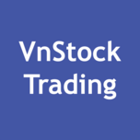
Revenue model
Brokerage
/Soft Dollars
/Commision
R&D for investment strategies
Brokerage
/Soft Dollars
/Commision
Stock Brokerage Companies
Các giao dịch chứng khoán liên kết chuỗi
X
= membership fee + commission from deals + sales from tokens

Slide 7
Target users
Banks
Corporate investors
High net worth individuals

Slide 8
Incentives for parties: B is trader, A-invetors are trade followers. The more A(s) join the contract, the higher sharing profits for B are. % return shared for parties is the effective added/substracted profit from the contract to each party; This metric is in-deal-capital-weighted.
Return on underlying deal 15.00%
% return shared = 15.00% - % Total ROE for each party
 | Beg. Net worth | Total %ROE | Ending Net worth | % return shared
B | 10,000,000 | 78.00% | 13,900,000 | 63.00%
A1 | 120,000,000 | 11.85% | 131,850,000 | -3.15%
A2 | 0 |  | 0
A3 | 0 |  | 0
A4 | 0 |  | 0
A5 | 0 |  | 0
 | Beg. Net worth | Total %ROE | Ending Net worth | % return shared
B | 10,000,000 | 699.00% | 44,950,000 | 684.00%
A1 | 120,000,000 | 12.76% | 132,836,312 | -2.24%
A2 | 300,000,000 | 11.97% | 330,181,736 | -3.03%
A3 | 900,000,000 | 11.88% | 989,904,073 | -3.12%
A4 | 30,000,000 | 11.88% | 32,997,588 | -3.12%
A5 | 12,000,000 | 12.95% | 13,302,163 | -2.05%
 | Beg. Net worth | Total %ROE | Ending Net worth | % return shared
B | 10,000,000 | 1653.00% | 92,650,000 | 1638.00%
A1 | 120,000,000 | 15.00% | 135,000,000 | -0.00%
A2 | 300,000,000 | 12.45% | 331,542,339 | -2.55%
A3 | 900,000,000 | 11.84% | 990,313,616 | -3.16%
A4 | 930,000,000 | 11.80% | 1,023,067,258 | -3.20%
A5 | 1,020,000,000 | 11.83% | 1,122,274,855 | -3.17%
 | Beg. Net worth | Total %ROE | Ending Net worth | % return shared
B | 10,000,000 | 678.00% | 43,900,000 | 663.00%
A1 | 120,000,000 | 12.71% | 132,781,964 | -2.29%
A2 | 300,000,000 | 11.98% | 330,164,809 | -3.02%
A3 | 900,000,000 | 11.89% | 989,897,727 | -3.11%
A4 | 0 |  | 0
A5 | 0 |  | 0

Slide 9
Revenue model
Marketing strategies
Brokerage
/Soft Dollars
/Commision
R&D for investment strategies
1
Brokerage
/Soft Dollars
/Commision
Stock Brokerage Companies
1
1
14% → 11%
14% → 44%
110
1
3 - 4
30
2
1000
30
14
With own commited capital
100
X
= Membership fee + commission from deals + sales from tokens

Slide 10
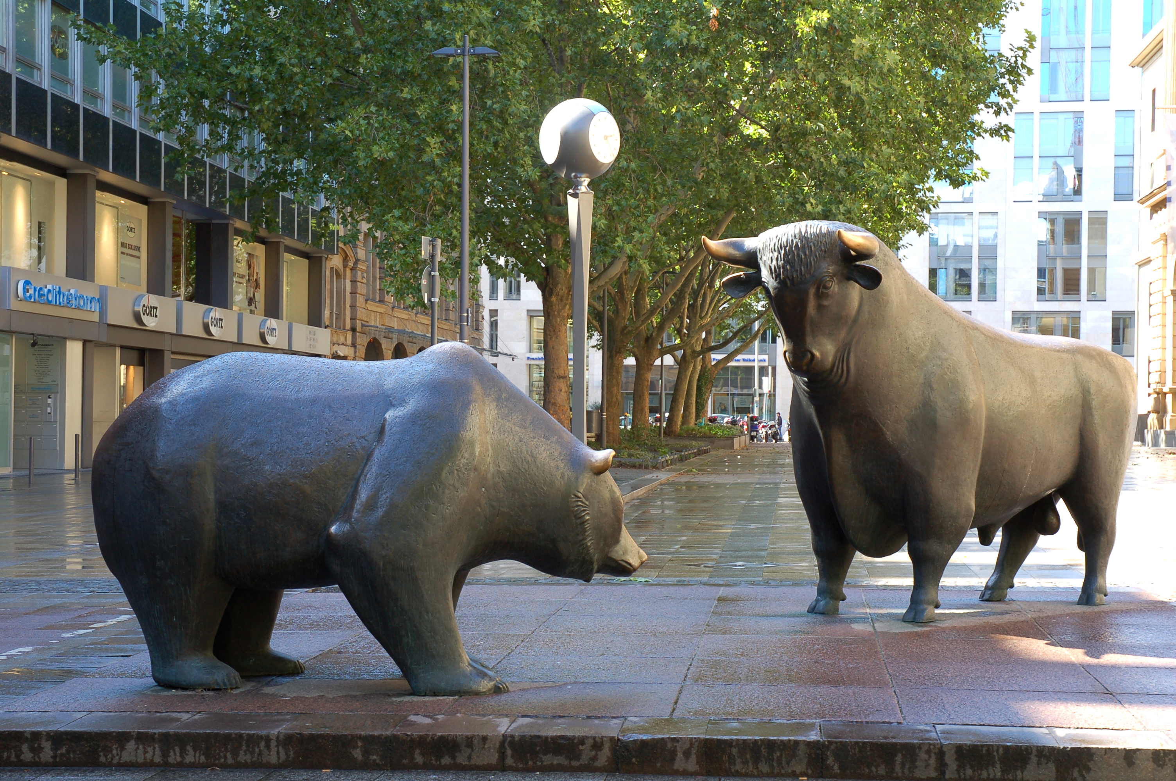
Revenue model
Marketing strategies
Our first time on public media:
- “Doanh nghiệp đầu tiên áp dụng công nghệ blockchain vào đầu tư chứng khoán Việt Nam” - https://goo.gl/fgMtGn
- Interview by HTV9 “Việt Nam bước đầu ứng dụng công nghệ blockchain” - https://goo.gl/bbk3eh
R&D for investment strategies
We have been developing the platform and raising an eco-system for knowledge and skill exchange. Traders and Trade followers exchange and share their skills and investment knowledge through our performance evaluation system. Users can learn to correct cognitive biases via our R&D and educational library.
Investors/Traders trading ideas are tested and enhanced through our R&D platform. The whole system accumulates insights into each investor's performance, adding value to any credit granting and financing application, risk management processes. The boundary between lending and co-investing is expected to be faded.
We are willing to open our API for any 3rd party to join and co-invest. Inversely, we allow our users to co-invest with them as in a symbiotic ecosystem. That would facilitate sharing of customer bases, while prioritize customer choice.
1
14% → 11%
14% → 44%
110
30
1
1000
30
14
100
Winvestor
Co-founders’ skill and experience are also marketing boosters
= Finance + Computer science + Math

Slide 11
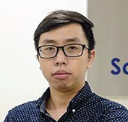
The Team 4 cofounders and 2 developers, 2 financial engineers
Minh Cong Pham, CFA - CEO (Financial issues)
Tuan Ngoc Do, CTO
(General tech issues)
Dat Tien Le, CSO
(Security issues)
- MSc Financial Analysis and Fund Management, University of Exeter
- Completing MSc Wealth Management, Singapore Management University
- Experience in running variety of early stage businesses; financial engineering and quantitative investment models.
- Experience in performance evaluation during working time at Temasek (Singapore)
- MA Computer Science, Completing PHD in Computer Science, Brandeis University
- Experience in startup engineering; in setting up big data system and distributed trading system; in creating deep learning algorithms in AI, computer vision and NLP.
- MA in Security and Mobile Computing, Royal Institute of Technology, PhD Candidate in Computer Science, University of Oslo
- Experience in hardware root of trust and system security. Experience in migrating hardware root of trust system. Experience in designing and testing secure networked system
Co-founders are classmates in top schools of Vietnam: High School for Gifted Students (Hanoi University of Science), Foreign Trade University and University of engineering and technology, where mutual understandings and bonds were nurtured.
Have years of work experience in financial engineering and quantitative models, research experience in AI and security, and entrepreneurship experience in distributed trading platform and cryptocurrencies exchanges.

Slide 12
Financials Achieve ments in 2017:
Established financial data server with auto-update financial data; and 7 proprietary quantitative models and research on investment strategies; 2 mobile app to providing realtime market information for trading
Data crawling feature to synchronize data between Winvestor and 3 securities company stock accounts : VnDirect, SSI, MBS.
Database of potential client of 2000 contacts (avg. of 3 contacts are passively collected per day), 400 registered free users and 13 paid users.
Run pilot trades for co-investment contract with voluntary stock accounts
Unit: USD
Success factor is marketing improvement. Business key indicator is marketing costs/user (the most sensitive input to the project outcome)
Realized cost per user 2017 is $529/user. Target marketing cost/user is $60/user
Below scenario based on underlying assumption of how marketing costs will be improved in 2018 year with other conservative assumptions.

